Slide 1
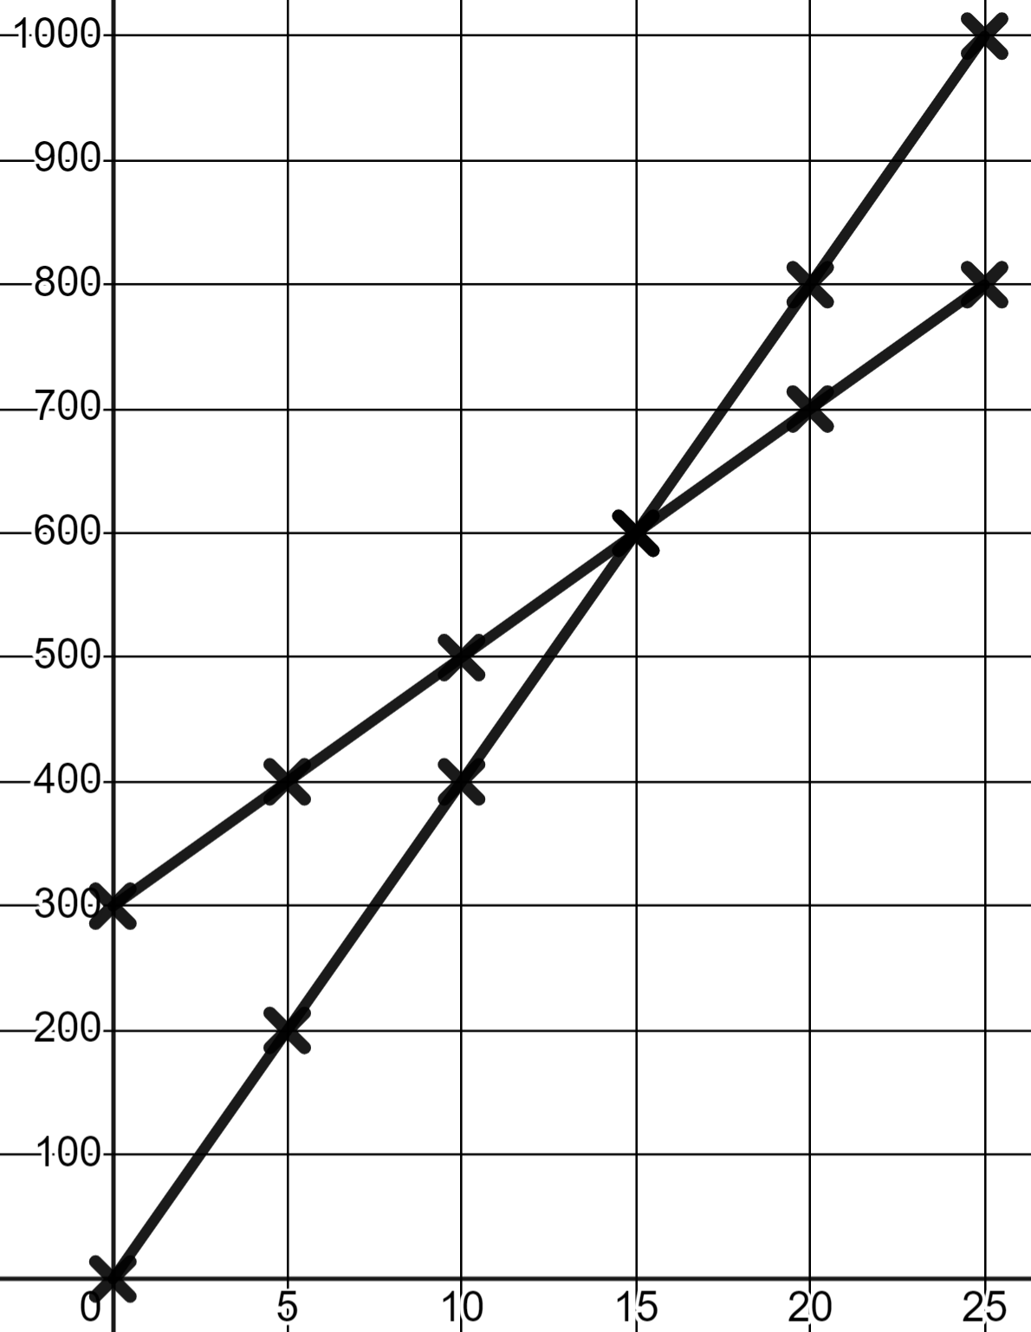
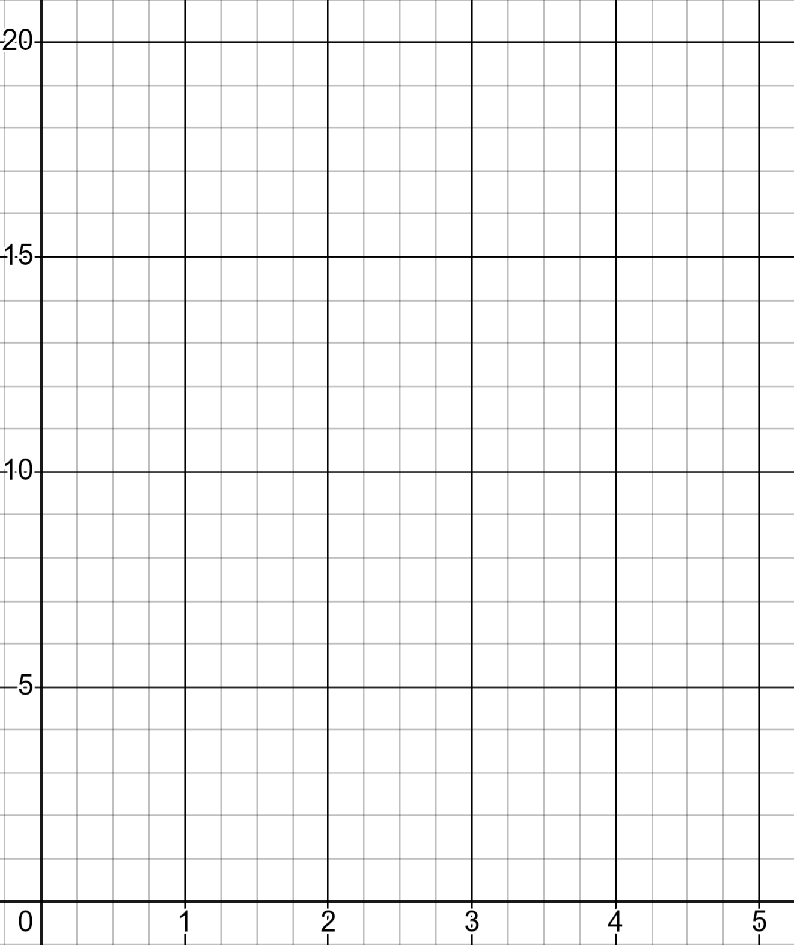
Problem solving with graphing linear relationships
Task A: Problems involving linear relationships
1) Andeep and Jun fill a bucket each from two different taps. This is graphed here.
a) Who started with some water in their bucket already?
Volume in ml (v)
b) Who had the smaller bucket?
Andeep
c) Whose tap has the faster rate of flow?
d) When was Andeep’s bucket half full?
Jun
Seconds (s)
2) In your town there are three taxi companies.
Fill in three tables f values and plot three lines.
Company A charge a flat rate of £4 then £2 for every mile travelled.
Company B charge a flat rate of £8 then £1 for every mile travelled.
Company C charge no flat rate and £4 for every mile travelled.
Cost in £ (c)
miles (m) | 0 | 1 | 2 | 3 | 4 | 5
cost in £ (s)
miles (m) | 0 | 1 | 2 | 3 | 4 | 5
cost in £ (s)
miles (m) | 0 | 1 | 2 | 3 | 4 | 5
cost in £ (s)
Miles (m)
2) b) Write a paragraph explaining the conditions in which each firm is best.

Slide 2
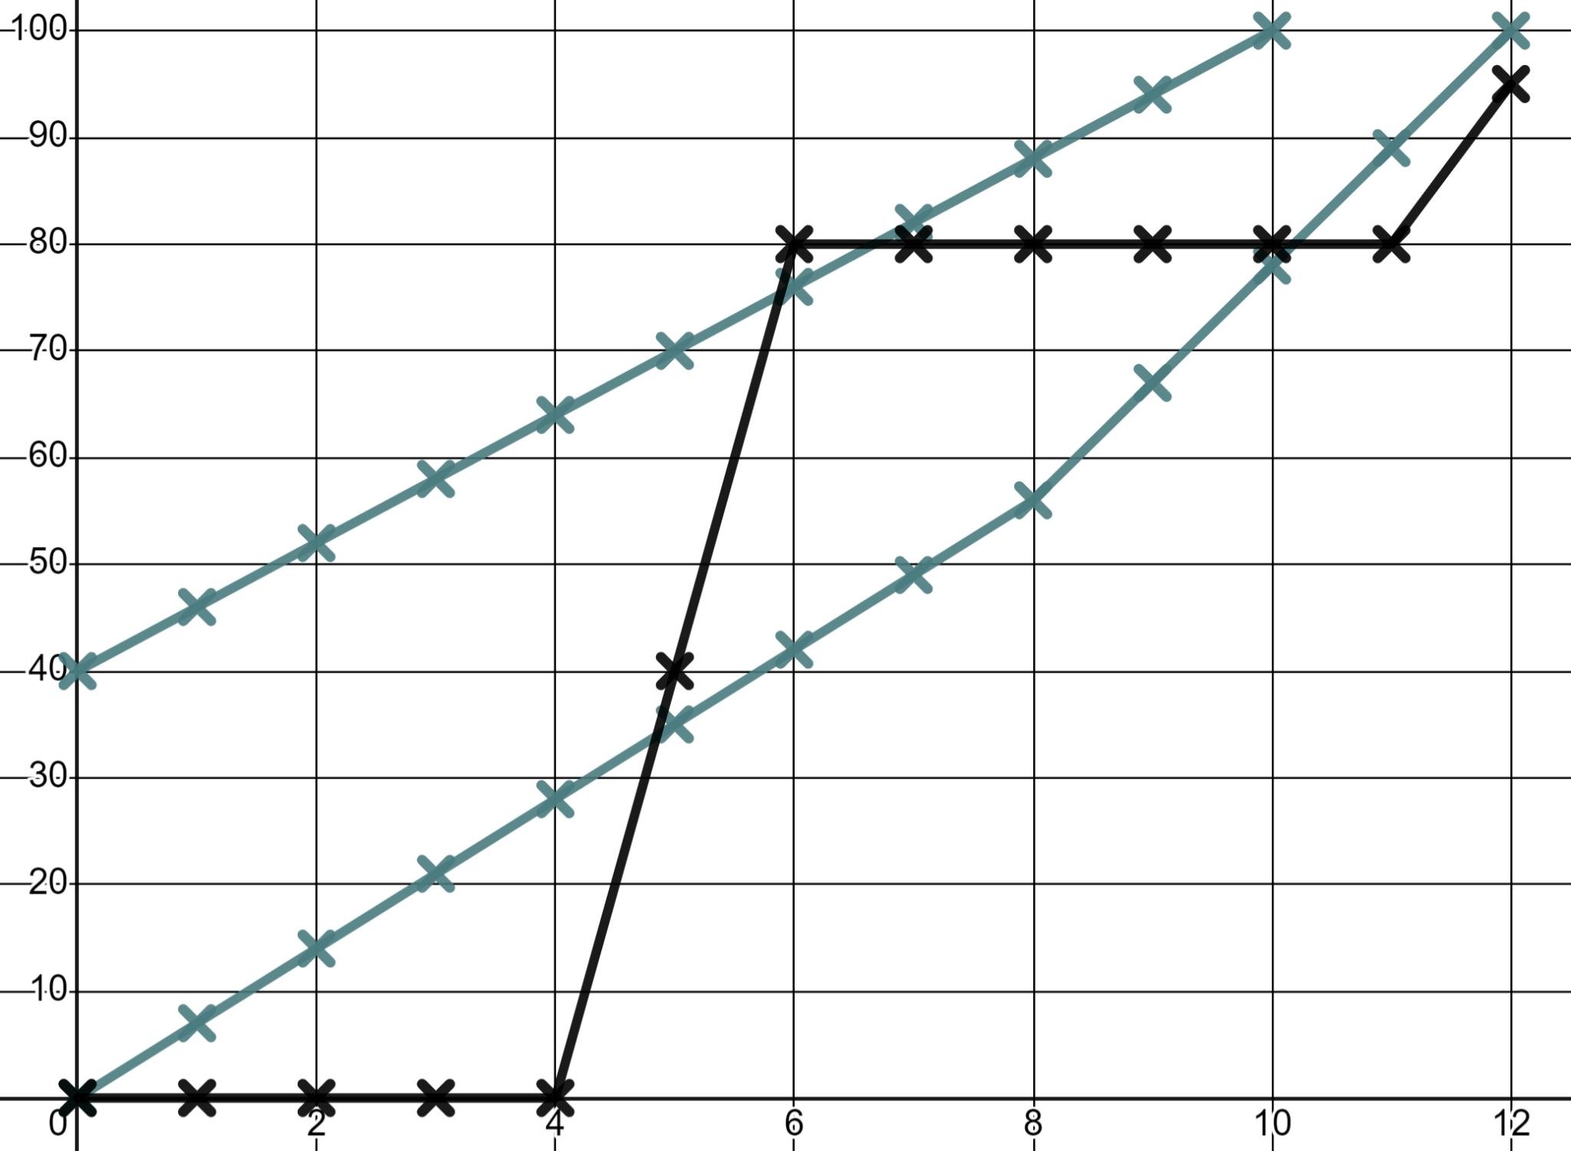
Problem solving with graphing linear relationships
Task B: Interpreting more complex linear graphs
1) Write a commentary to describe this race.
d
The distance units are metres. The time is in seconds.
Sofia
Keep your commentary in chronological (time) order.
Andeep
Laura
t
Mathematics in Education and Industry
v2.2

